Slide 1

OnLine Analytical Processing (OLAP) and MDB: BI Cubes
Kurt Friedrich Spring 2020 Part 1
Hold one tight, you are about to get a13 week BI course in 2 lectures!

Slide 2


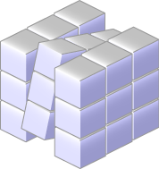
Reporting versus Analysis
CBslide
Reporting
Analysis
Which customers spent the most?
Which customers are most profitable?
What did this customer buy?
What is this customer likely to buy next?
What was the Q4 revenue forecast?
What if demand falls short of forecast?
What happened?
What If?

Slide 3
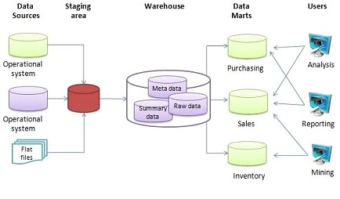
An operational data store (or "ODS") is used for operational reporting and as a source of data for the Enterprise Data Warehouse (EDW). It is a complementary element to an EDW in a decision support landscape, and is used for operational reporting, controls and decision making, as opposed to the EDW, which is used for tactical and strategic decision support.

Slide 4


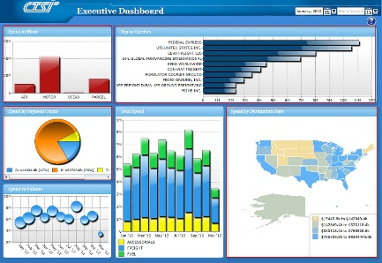
How BI, DW and DI Fit Together
CBslide
Data Integration
ETL/ELT
SOA
Data Quality
MDM
Etc….
Data Warehousing
Data Warehouse
Data Marts
OLAP Cubes
ODS
Etc….
Business Intelligence
Reporting
Dashboards
Data Visualization
Operational BI
Etc….
Extract, Transform and Load
Operational Data Store
Notes:
Data integration integrates and cleanses data from multiple sources
Data warehousing (as a broad category) stores integrated data
Business Intelligence presents and analyzes information.

Slide 5
SOA
enterprise service bus (ESB) : communication system between interacting applications in a service-oriented architecture (SOA). It represents a software architecture for distributed computing,
MDM
Master data management is a process that creates a uniform set of data on customers, products, suppliers and other business entities from different IT systems. One of the core disciplines in the overall data management process, MDM helps improve data quality by ensuring that identifiers and other key data elements about those entities are accurate and consistent enterprise-wide.
Data quality
Data quality refers to the state of qualitative or quantitative pieces of information.
There are many definitions of data quality, but data is generally considered high quality if it is "fit for its intended uses in operations, decision making and planning".
Moreover, data is deemed of high quality if it correctly represents the real-world construct to which it refers.
Furthermore, apart from these definitions, as the number of data sources increases, the question of internal data consistency becomes significant, regardless of fitness for use for any particular external purpose

Slide 6
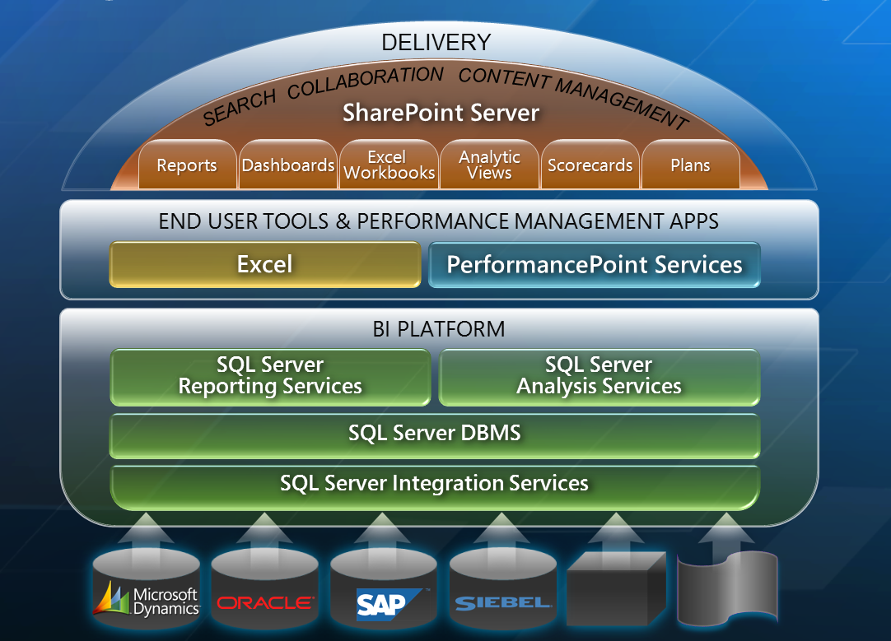
Tableau

Slide 7
Visualization tools built on top
https://youtu.be/mvkNi0rtSkE

Slide 8
Multidimensional Database (MDB)
MDB is a type of database optimized for data warehouse and online analytical processing (OLAP) applications.
They are generally loaded with data from existing relational databases that are being updated with real time information.
Instead of using the SQL query language, MDBs are accessed with an MDX query language, or using many business apps such as Excel, SharePoint, and many special purpose built apps (Tableau) that allow companies to make better pricing, inventory, and other decisions.
They allow questions like “which of my cereal brands are selling the most and what is the most common product that is sold at the same time”?

Slide 9
MDB in support of OLAP
Repeat
It is common with MDB to use a “data cube” model to represent the dimensions of data available to a user.
For example, “internet sales" could be a “fact table” (called a measure) where actual sales activity is stored (facts, data)
It can be interrogated and correlated across several “dimensions” such as geography, time, and product detail dimensions.
Dimension attributes are often broken down into hierarchies such as Year, Quarter, and Month.
MDBs are generally quite de-normalized to support fast, complex queries. This is less optimal for data storage space, but optimizes complex query speeds.
Technologies such a SSIS (SQL Services Integration Services) are used to periodically refresh the fact tables, such as at the end of a retail day.
Fact Tables 1. Provides measurement of an enterprise, in numeric or integer form, determined by observation.
2. Size of Fact Table is (much) larger than Dimension Table.
3. Fact table data has foreign keys that refer to primary keys in the dimension tables.
4. A dimension table consists mainly of descriptive attributes that are textual fields.

Slide 10
Multidimensional Database (MDB)
OLAP consists of 3 operations: consolidation , drill-down, and “slicing and dicing”.
Consolidation involves the aggregation of data that can be accumulated and computed in one or more dimensions. For example, all sales offices are rolled up to the sales department to anticipate sales trends. (The structure used is generally a “cube”.)
This step takes selected (filter) subsets of data from the DW,
And effectively does many pre-joins of some of the data
To translate a giant DW down to an optimized subset of the data targeted for some particular analysis.
Different Dept’s, and even different groups in 1 Dept would have a batch process to load up unique cubes every Sunday, or every night at midnight etc. If you make a cube too flexible (too many dimensions) it becomes too slow.
Drill-down is a technique that allows users to navigate through the details. For instance, users can view the sales by individual products that make up a region’s sales.
Slicing and dicing is a feature whereby users can take out (slicing) a specific set of data of the OLAP cube and view (dicing) the slices from different viewpoints.

Slide 11
simple example
Repeat
A cube that contains a store's sales as a measure (fact table), and Date/Time and Product as a dimensions. Each Sale has a Date/Time label, Product, etc that describes more about that sale.
Sales Fact Table
sale_id | sale_amount | time_id | Prod_id | …
12134 | 208.10 | 1364 | 789 | …
12135 | 600.50 | 1456 | 236 | …
… | … | … | … | …
More
dimensions
Time Dimension
Product Dimension
time_id | timestamp
1364 | 20140209 12:35:43
1365 | 20140902 12:37:14
… | …
Prod_id | English Desc | List Price | Color | …
789 | Xbox 360 Console | 240.00 | Black | …
790 | Xbox 360 Controller | 24.99 | White | …
… | … | … | … | …

Slide 12
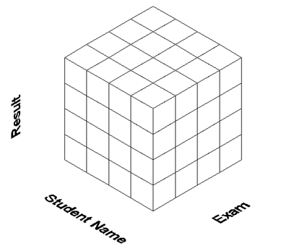
In a multi-dimension database system
the data is presented to the user in such a way as to represent a hypercube, or multi-dimensional array, where each individual data value is contained within a cell accessible by multiple indexes. Here is a simple example showing exam results in a MDB. This database contains three dimensions, namely Result, Student Name and Exam.
An individual student may have their exam results for several exams compared over a period of time, for example a four-year undergraduate course. This ability to present data in such a top level view is unique to multi-dimensional systems.
The measure/fact data is inside the intersections in the small cubes, having been pre-computed and loaded when the cube was built. Cubes are read only.
Fact: Results
Dim: Student Name
Dim: Exam

Slide 13
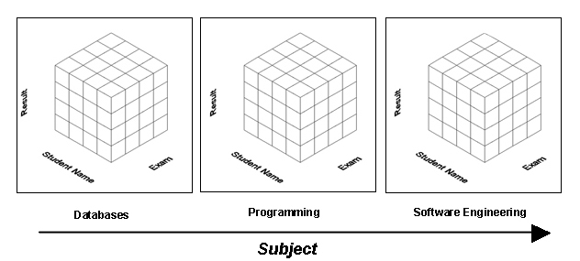
4 dimensional
A multi-dimensional system is not limited to three dimensions , but when we go to 4, 5, 10 dimensions, it becomes more difficult to present such structures in a pictorial view. Using the previous example; let us now add a fourth dimension called Subject. Let us assume our students study computer science, with subjects in Databases, Programming and Software Engineering. If we imagine this new dimension as being a box containing our previous three dimensions, then we would have three such boxes, namely one for each subject that our students were tested on. But this diagram doesn’t convey the independence of each of the 4 dimensions as seemed more obvious in the 3d model.

Slide 14
Advantages of Multi-Dimensional Databases over Relational Databases
Sticking with the student exam result dataset, assume that the rate of change of the data is not extremely high, and the primary use of the data is to analyze it, not so much change it.
If so, then there are reasons why it is more efficient to represent our dataset with a multi-dimensional array rather than a relational table.
All similar information is lined up in a single dimension, like Results, so that data can be very quickly summed up to a total or quickly compared to get an immediate idea of how student results are fairing this semester.
The multi-dimensional array structure represents a higher level of organization than the relational table (which we normalized, destroying the obvious relationship among the columns in several tables.)
The structure itself represents a more intelligent view of the data it contains, because our perspectives of this data (how we chose to think about it) are embedded directly into the structure as dimensions as the cube was constructed, as opposed to being placed into fields. Building a Cube is akin to a very large complex query that outputs just the data we want to analyze, with some pre-accumulations done.

Slide 15
Example, if we design a relational table for student results, it might look like:
Student Name | Exam | Result
John Collins | Databases | 70
John Collins | Programming | 72
John Collins | Operating Systems | 60
Larry Wall | Databases | 80
Larry Wall | Programming | 99
Larry Wall | Operating Systems | 70
Linus Torvalds | Databases | 80
Linus Torvalds | Programming | 90
Linus Torvalds | Operating Systems | 99
The structure of this relationship table tells us nothing of the nature of the contents of these fields, only that there are three fields Student Name, Exam and Result, and there are nine records.
In fact, this table would likely be the result of a join across 3 tables, making the relationships even more obscure.

Slide 16
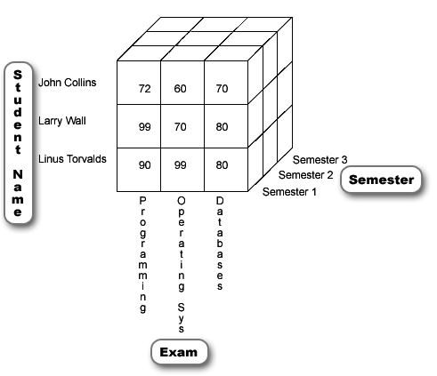
If we were to present a three-dimensional view of this data, while adding a third dimension called Semester,
There is no need to have Result as a dimension, the exam results are contained within the cells (small cubes) of the database structure.
Another advantage is the removal of the duplication in the relational table, where each student name was repeated three times for each exam that they participated in. In the multi-dimensional view, the Student Name and the Exam become dimensions, or in effect indexes into that data, so having duplicates does not make any sense.
Notice all related information lines up in this 3d view,
- Programming results for John Collins over all 3 semesters lines up along the z-axis
- Exam results for Linus Torvalds in all subjects lines up on the x-axis
- Databases results for all students line up on the y-axis
If using Relational tables, such views of specific data would require writing complex SQL queries.

Slide 17
A Rake makes a poor shovel!
Although deceptively simple to design and operate, relational database simplicity for the end-user does fall down when it comes to complex running queries.
Accessing data from relational databases may require complex joins of many tables and is distinctly non-trivial for untrained end-users, who may be forced to hire IT professionals to structure such queries in a query language, such as SQL.

Slide 18
No such thing as a free lunch
Typically a Cube is “built” by importing a subset of data from a SQL system(s).
The SQL system is used as the “db of record”. Business is done out of SQL (accepting orders, changing stock levels, paying bills, etc)
It stores ALL data for a company, while a Cube stores only extracted data SQL (subset of all tables, subsets of rows within tables) based on the analysis that is desired.
It typically operates on “stale” data from snapshots taken, say, every night at midnight.
If a dataset in a table is not multi-dimensional, as there is no inherent relationship between the elements of the different records, then it does not make sense to map that data into a cube (next slide)

Slide 19
And we create an MDS two-dimensional view or slice of this information, where Lastname and Firstname are the dimensions, and Age is contained within the cell values, as below:
Supposed we had a SQL table with this information
Lastname | Firstname | Student No | Age | Course
Collins | John | 111 | 25 | Comp Science
Wall | Larry | 222 | 55 | Comp Science
Torvalds | Linus | 333 | 26 | Comp Science
 | Collins |  |  | 25
Lastname | Wall |  | 55
 | Torvalds | 26
 |  | Linus | Larry | John
 |  | Firstname
* Our slice yielded a 3x3 array containing 9 cells, but only 3 of these cells actually contain an age value, leaving 6 empty! That dataset in the SQL table is not multi-dimensional, as there is no inherent relationship between the elements of the different records.
* As for performance, in relational form, a search would require 3 comparisons, whereas in MDS a search would require 9 comparisons (3x3), thereby reducing efficiency.

Slide 20
Multi-dimensional or Relational Database?
This raises a fundamental observation: multi-dimensional database technology is a complementary technology to relational database technology, not a direct replacement.
A further observation can be made for the business application of multi-dimensional systems at this stage (Kenan): The greater the number of inherent inter-relationships between the elements of a dataset, the more likely it is that a study of those inter-relationships will yield business information of value to the company. (is there any relationship between the items you buy at the grocery store, that day of the week, that time of the day, if it was cold or hot out that day?)
It is clear that where these inter-relationships exist, especially in a commercial environment, that such relationships have a real-world meaning to the organization that is worth analyzing over time
Hence the process of trend analysis, via OLAP (On-Line Analytical Processing) using MDS systems.
Indeed it has become evident that the process of management is greatly aided by information arranged by subject (dimension) rather than by operational applications (Baum 1996).

Slide 21
Additional Multi-Dimensional Database Advantages
Enhanced Data Presentation and Navigation: Intuitive spreadsheet-like views of the data are the output of multi-dimensional databases. Such views are difficult to generate in relational systems without the use of complex SQL queries.
Ease of Maintenance: Multi-dimensional databases are very easy to maintain, because data is stored in the same way as it is viewed, that is according to its fundamental attributes, so no additional computational overhead is required for queries of the database. To compare this to relational systems, where complex indexing and joins may be used that require significant maintenance and overhead.
Increased Performance: Multi-dimensional database achieve performance levels that are well in excess of that of relational systems performing similar data storage requirements. These high performance levels encourage and enable OLAP applications. Performance can be improved in relational systems through database tuning, but the database cannot be tuned for every possible on-the-fly query. In relational systems, tuning is quite specific, therefore decreasing flexibility, and also requires expensive database specialists.

